Slide 1
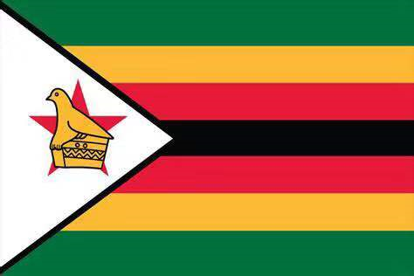

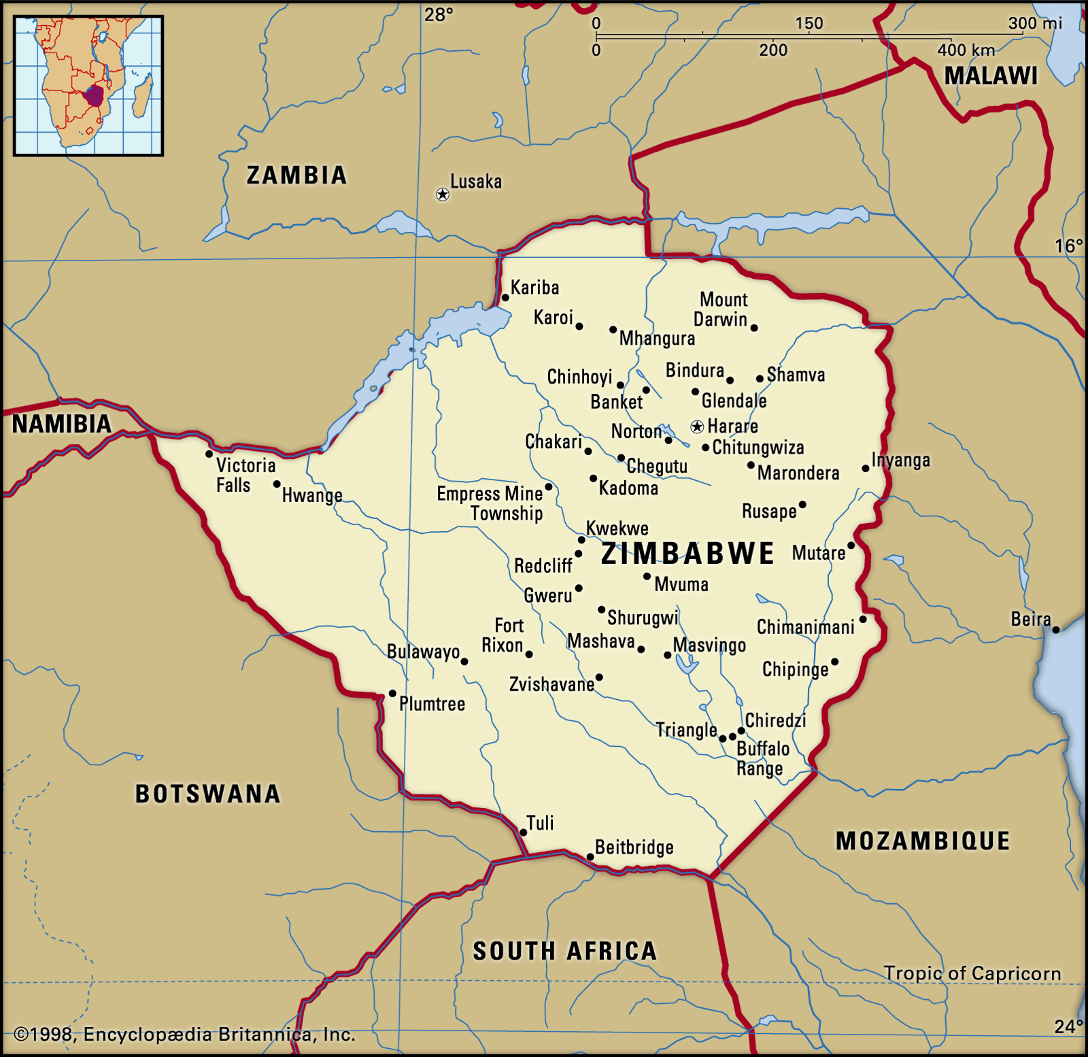
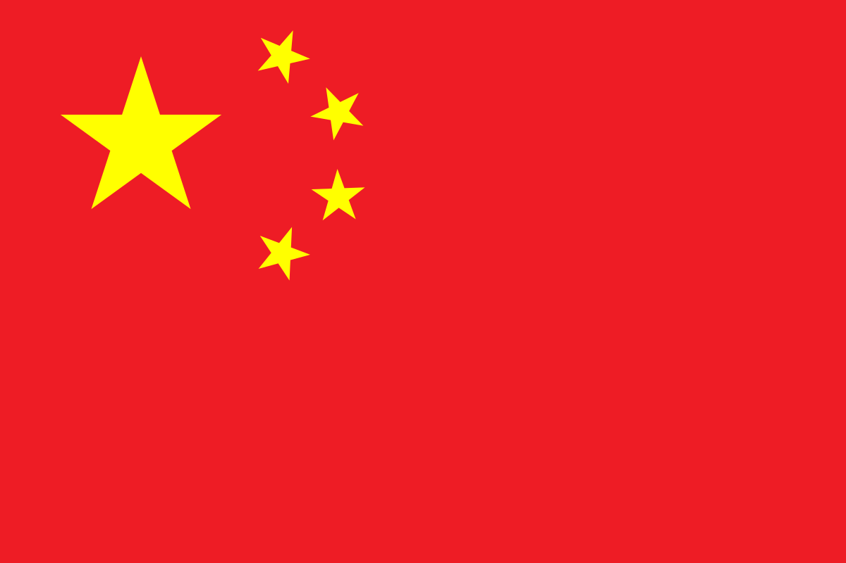
亚历克上 - M202161029
OVERVIEW OF JILIN PROVINCE CHINA

Slide 2
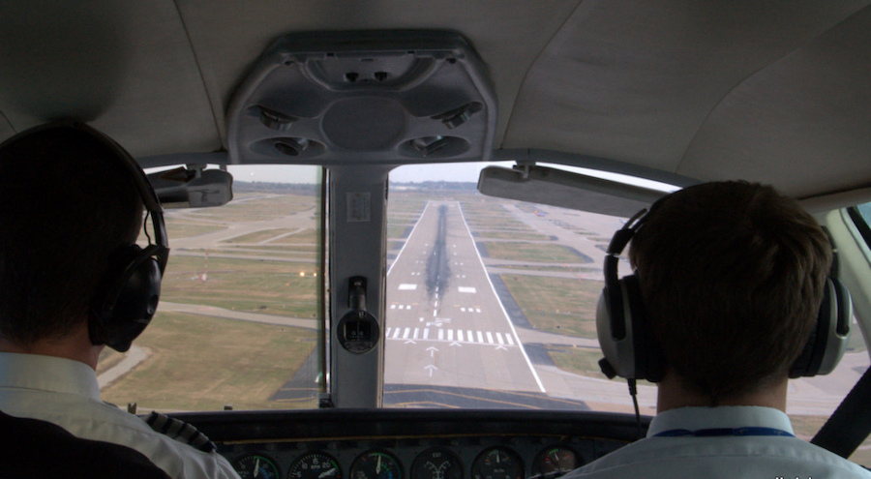



Slide 3
Jilin Province of China
China has 23 provinces and Jilin is one of them.
Jilin is 187.400km² which is 0.0195269355 of the total land which makes up china.
Jilin is 1133 km from Beijing the capital city.
Jilin
Beijing
Without wasting time lets zoom in Jilin province.
Now things start getting interesting because Jilin is a place of so many activities , beautiful scenaries, nature , beautiful people and so on.
Lets dive in.

Slide 4
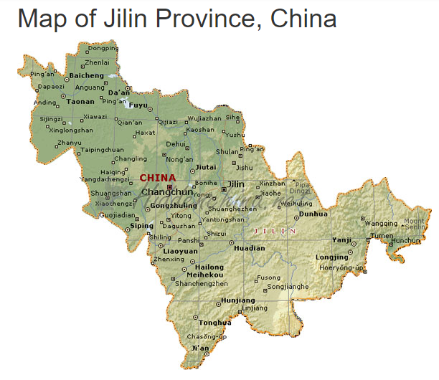
Changchun Capital of Jilin Province
Jilin is in Qing Dynasties
A green city
More than 30 districts

Slide 5
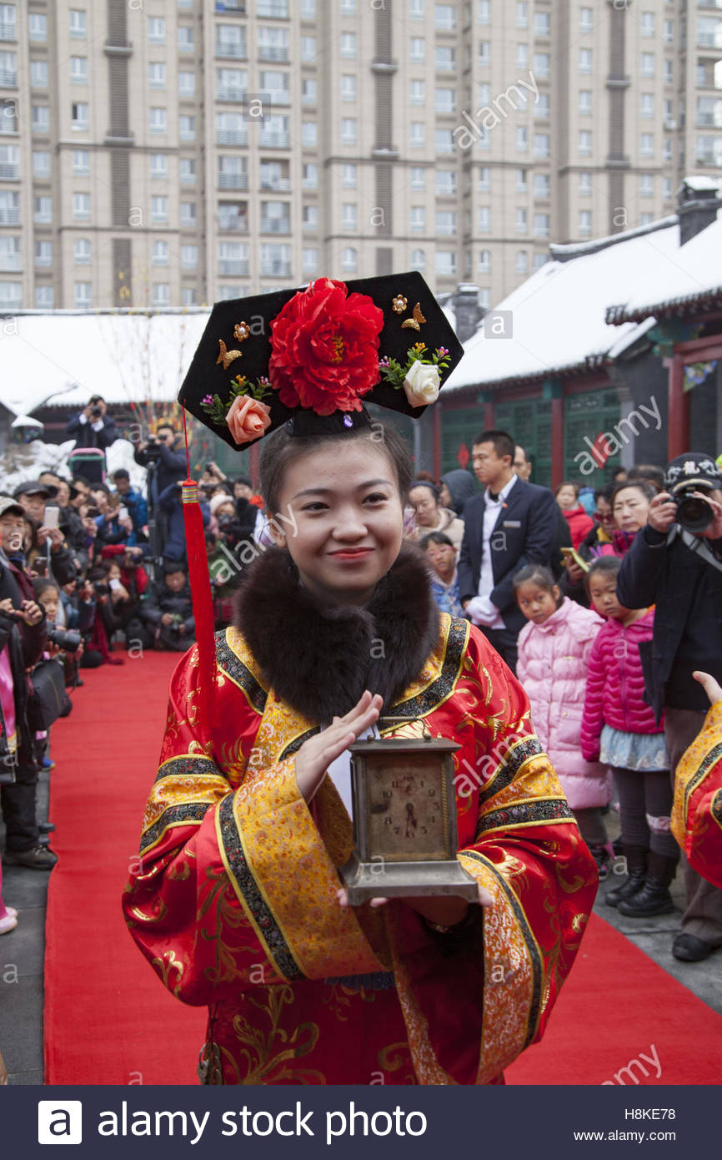
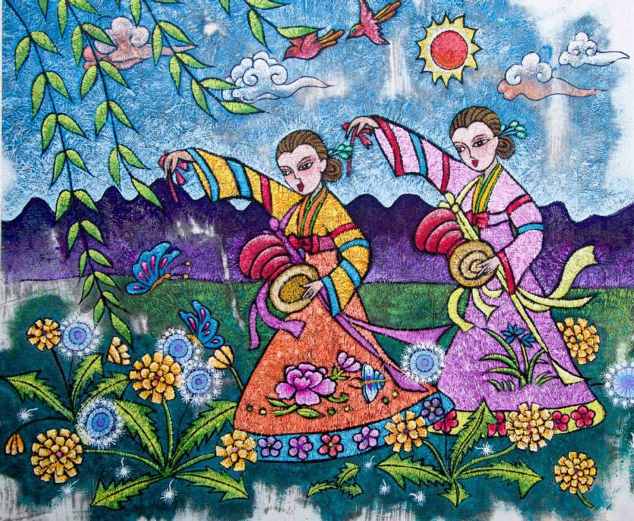
Ethinic groups in Jilin can be tracked 1800 years back , As per now they are 91% Korean, 4% Manchu, 0.6% Mongol, Hui 0.5%. They are 2 main languages in Jilin which are Northeastern Mandarin and Hamyong Korean.
Jilin Culture & Ethinic Groups
Well known for noasting rich cultural resources, Jilin province in northeastern China has been given many accolades and is often hailed as a hometown of Chinese folk culture and art, of Chinese modern folk painting, and as “the hometown of Chinese Songhua inkstones”. The Changchun Film Studio is the cradle of Chinese films.

Slide 6
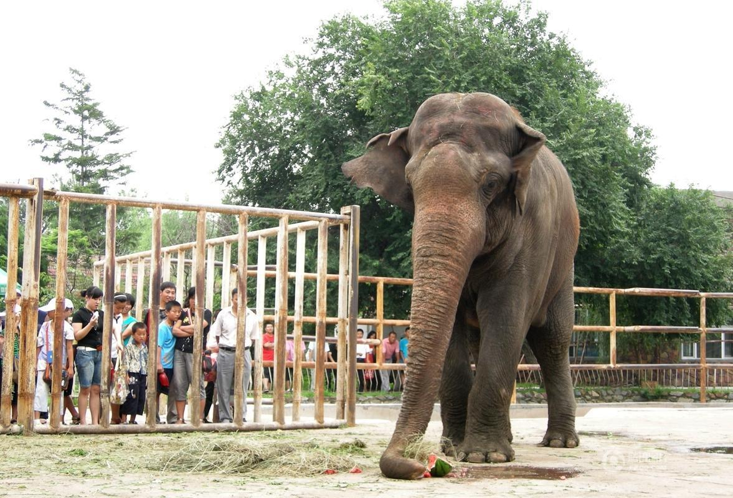
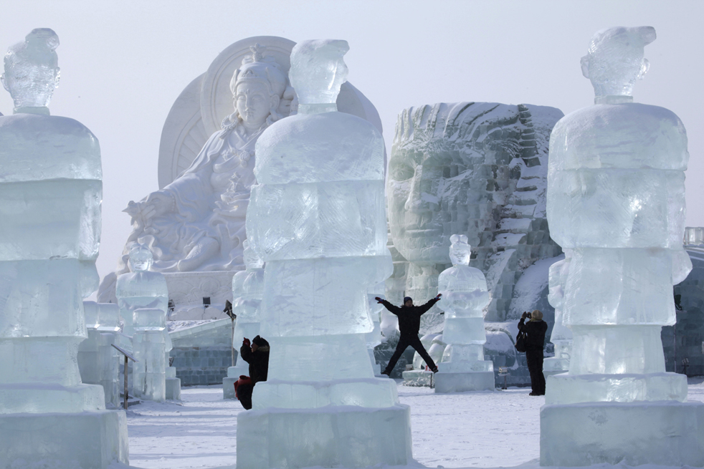
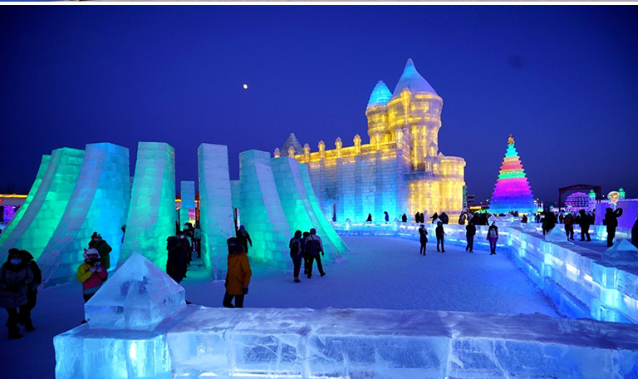
National Parks in Jilin - Changchun
Tourist Attraction
Snow temples, Snowman & Snow activities
They are lot of national parks in Jilin and in these national parks huge animals like elephant, lions, tigers and buffalos can be found and they are friendly to people. Millions of people visit Jilin to watch animals.
Jilin is well known for heany snow through out the year and lot of places have beautiful scenaries for example Jingyue Snow World. Every year tourist visit this place for this mavelous snow temple and lot of snow activities.

Slide 7
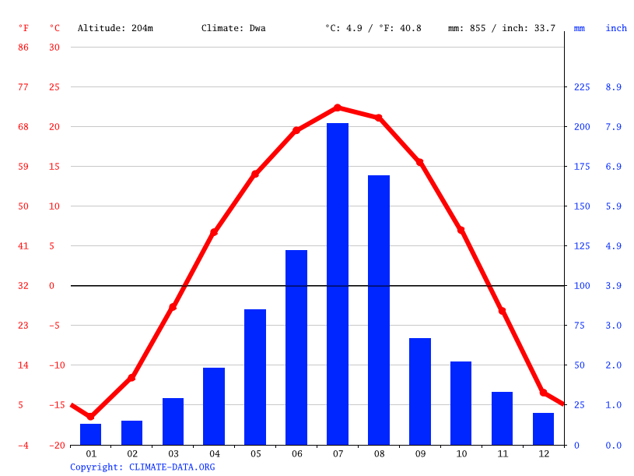
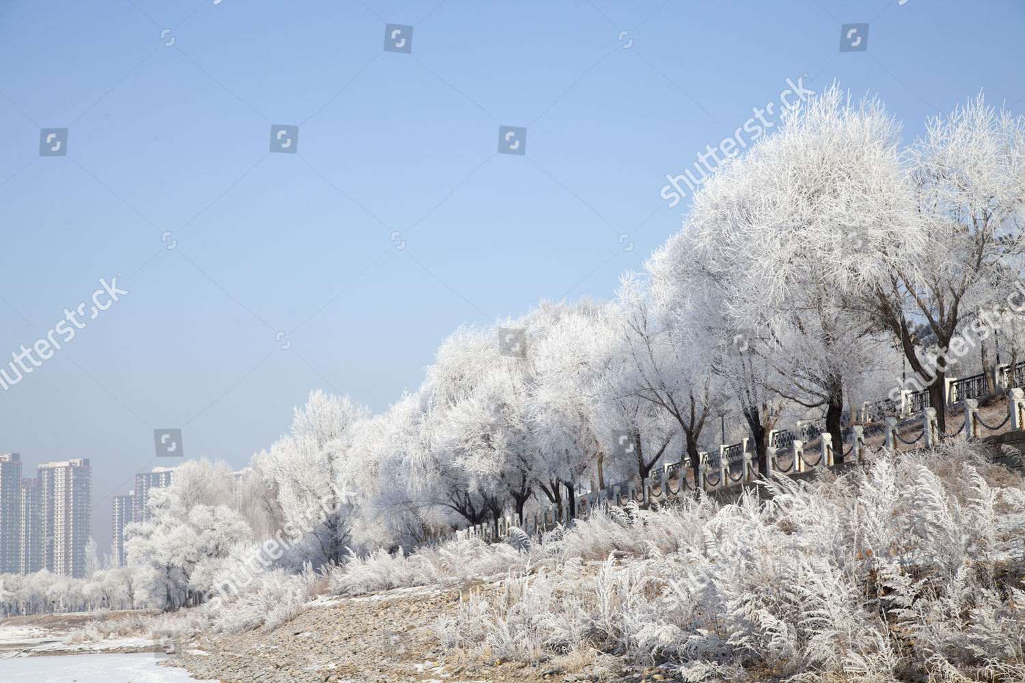
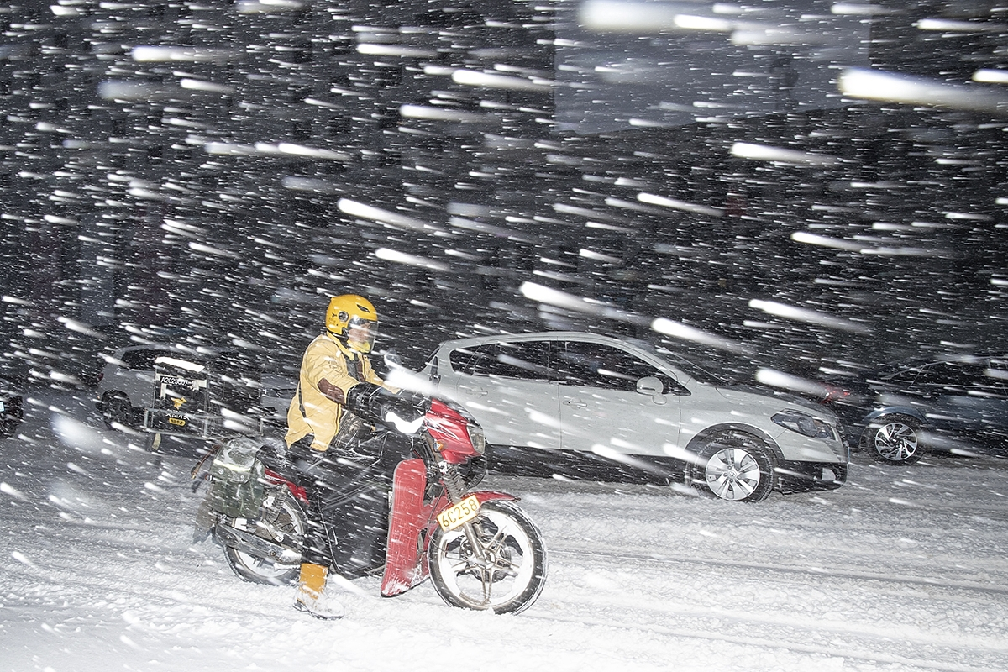
Weather conditions
We have seen how amazing Jilin is and how great it is. But to visit this place you need to know the following .
Ladies and gentleman this what you have to be ready for by visiting Jilin , it snows 80% of the time.
These trees are’nt white by nature , its snow .

Slide 8
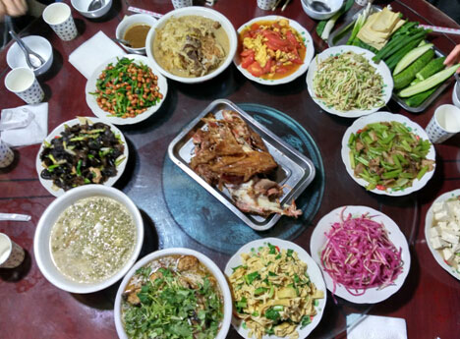
Food
We can’t call it a day if we don’t mention anything about food.
Jilin cuisine, also known as Ji cuisine, belongs to the subcategory of Northeast cuisine is the main dish of Jilin Province.
Characteristics
Steamed White Fish
Ginseng Chicken
Kebabs
Fried Vermicelli
Cold Noodles
Others Food.

Slide 9
